Slide 1
Hypothesis Testing
CSCE 587

Slide 2
Background
Assumptions:
Samples reflect an underlying distribution
If two distributions are different, the samples should reflect this.
A difference should be testable

Slide 3
Model Evaluation
Issue: limited observations
Questions:
What is the appropriate test
What level of significance is appropriate

Slide 4
Test Selection
One sample test:
compare sample to population
Actually: sample mean vs population mean
Does the sample match the population
Two sample test:
compare two samples
Sample distribution of the difference of the means

Slide 5
Selecting the Test
Type of problem:
Comparing a sample to a population
“Does the sample come from the population?”
Test: One Sample t-test

Slide 6
One Sample t-Test
Test: One Sample t-test
Used only for tests of the population mean
Null hypothesis: the means are the same
Compare the mean of the sample with the mean of the population
What do we know about the population?

Slide 7
Example
Historically, the mean score for juniors on a test is 81.3
Six students take the test resulting in a mean score of 87.6 and a standard deviation of 13.14
The t-value is:

Slide 8
Example
Given t= 1.176, how do we test the hypothesis?
Compare to critical values in t-table.
To do so we need:
to know the degrees of freedom
To select a confidence interval
One-tailed or two-tailed test?

Slide 9
One-Tailed vs Two-Tailed
One-tailed:
allots all of the alpha in one direction
Makes sense if we want to know a difference in one direction
or

Slide 10
One-Tailed vs Two-Tailed
Two-tailed: we only care if the means are different
Splits alpha into two tails
Makes sense if we are only asking if the means are different

Slide 11
Example
The degrees of freedom
DoF for one sample test is n-1 = 5 in this case
To select a confidence interval
We select 95% confidence interval
One-tailed or two-tailed test?
One-tail allots all of the alpha in one direction
Makes sense if we want to know a difference in one direction
Two-tailed: we only care if the means are different
We choose two-tailed

Slide 12
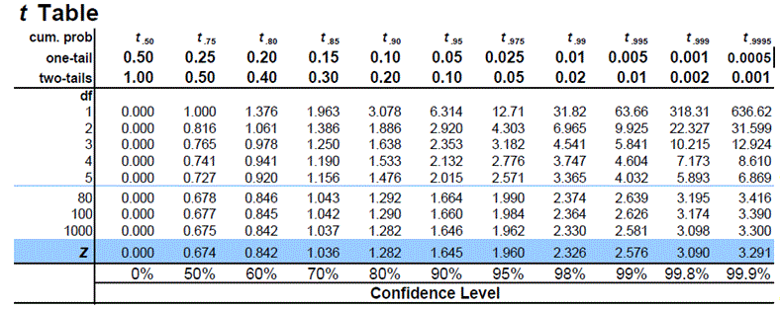
Example
Parameters: t= 1.176, DoF=5, 95%, 2-tailed

Slide 13
Decision
Compare t= 1.176, and = 2.571
Accept or reject the null hypothesis?
If ➔ Reject null hypothesis
If p-value < α ➔Reject null hypothesis

Slide 14
Steps We Took
Selected the test
Selected confidence level
Calculated the test statistic
Determined the degree of freedom
Compared the computed test statistic to the table value
Accepted/Rejected the hypothesis

Slide 15
Test Selection
One sample test:
compare sample to population
Does the sample match the population
Two sample test:
compare two samples
Sample distribution of the difference of the means

Slide 16
Two Sample Tests
Independent two-sample t-test
Independently sampled
Identically distributed
What does this mean?
Paired two-sample t-test
Paired, not independently sampled
Example: sample, treat, resample same subjects

Slide 17
Independent two-sample t-test
Must have same variance
Numerator: difference between samples
Denominator: estimated standard error of the difference between the two means
Note the above version allow unequal sample sizes

Slide 18
Independent two-sample t-test
Denominator: estimated standard error of the difference between the two means
Where:
And are the unbiased variances of the two samples

Slide 19
Degrees of Freedom
One sample test: n1 + n2 – 1
Two sample test: n1 + n2 – 2
Why the difference?
For a sample: DoF = n-1
We have two samples: (n1-1) & (n2-1)

Slide 20
Independent t-test, unequal sizes, unequal variances
Use Welch’s t-test
Difference is in the denominator
Where, are the unbiased variances of the two samples

